Slide 1
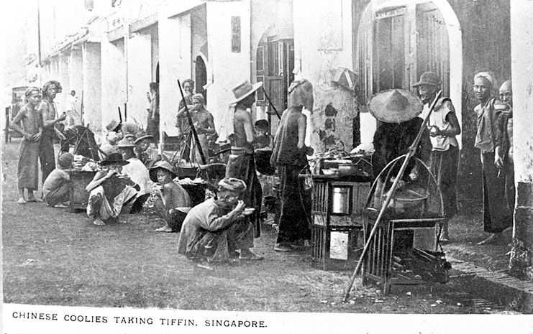
The Chinese Community
GES1009/SSA2203
Lecture 3 (II) AY2018-19

Slide 2
From 1849 Chinese represented the majority of the population.
Hokkiens, Cantonese, Teochews,
Hainanese and Hakka
Mass migration from the mid 1800s onwards…push and pull factors.
Chinese merchants were dominant in Singapore’s commercial life.

Slide 3
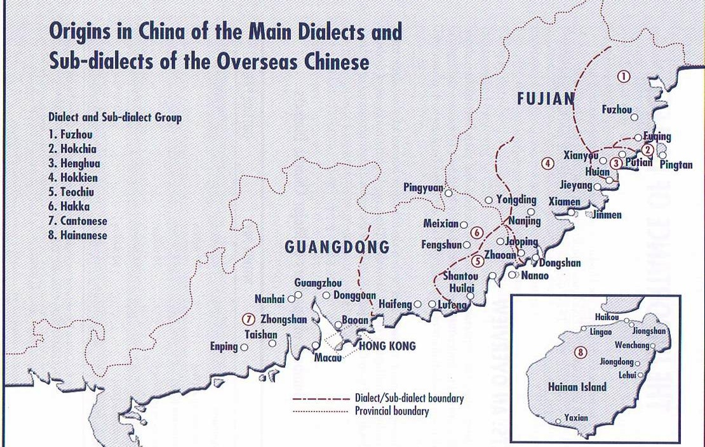

Slide 4
Migration —Basic Patterns
1. Chinese Trader (Huashang)
-established businesses at various ports
- used family/kinship to expand their business networks
- retention of links with China was important
2. Labourers and Coolies (Huagong)
- Indentured or ticket labour system
- A system marked by exploitation, ill- treatment and poor working conditions
3. Overseas Chinese (Huaqiao)
- Any Chinese that had left the homeland…
- This term took on political significance in the 20th Century

Slide 5
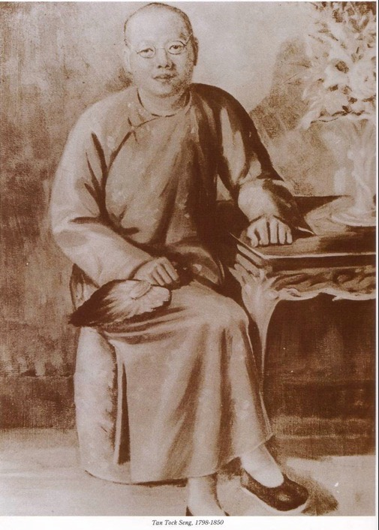
Hokkien community
Largest group (included many Straits-born Chinese)
Temples: Hengshangting c.1828.
(Tiong Bahru)
Thian Hock Keng Temple (Telok Ayer St)1842
Tan Tock Seng- prominent community leader.

Slide 6
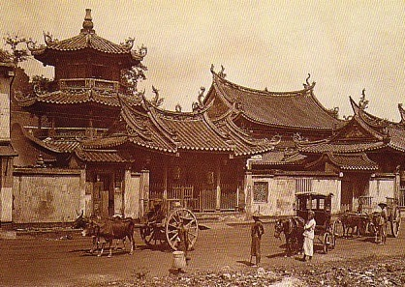
Thian Hock Keng Temple

Slide 7
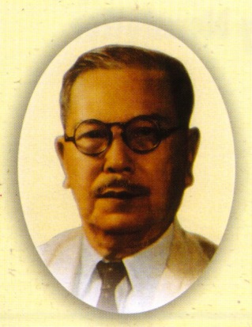
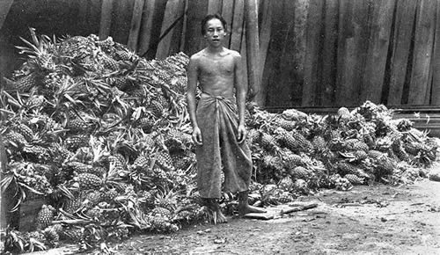
Tan Kah Kee
Pineapples
Tin
Rubber
Early business experience in his father’s firm.
A leading community and business figure pre WWII.

Slide 8
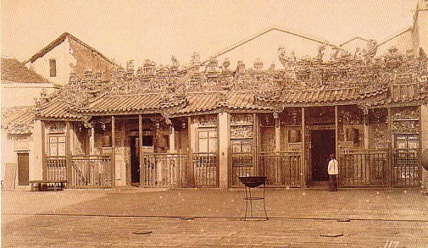
Teochew community
Gambier and Pepper
Philip Street temple: Wak Hai Cheng Bio
Ngee Ann Kongsi- (1845) under leadership of Seah U Chin

Slide 9
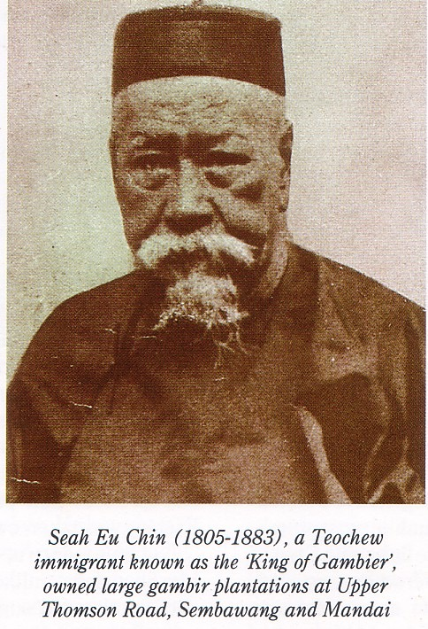
Teochew - trades
Gambier and pepper
Marine products
textiles
Rice, glassware, ceramics
Trades that relied on inter-regional links.

Slide 10
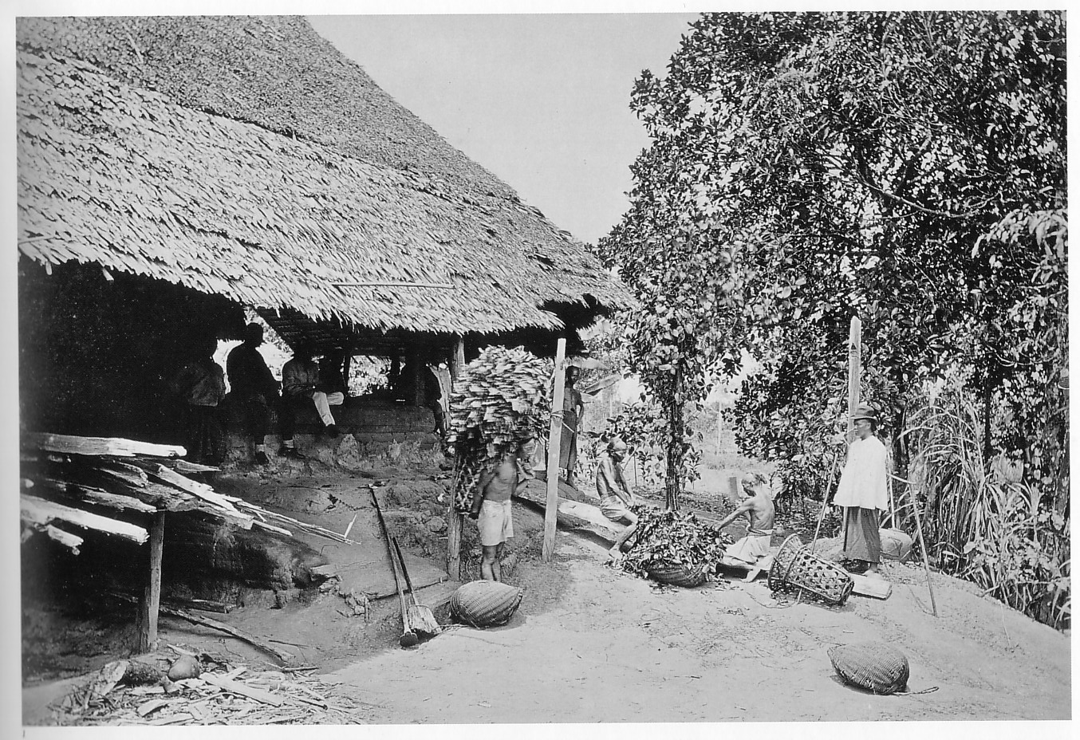
Gambier processing

Slide 11
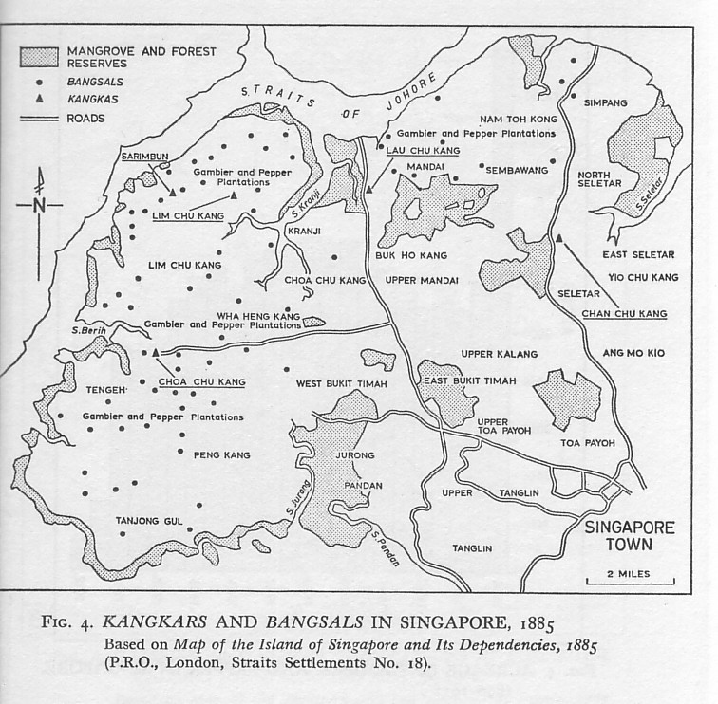

Slide 12
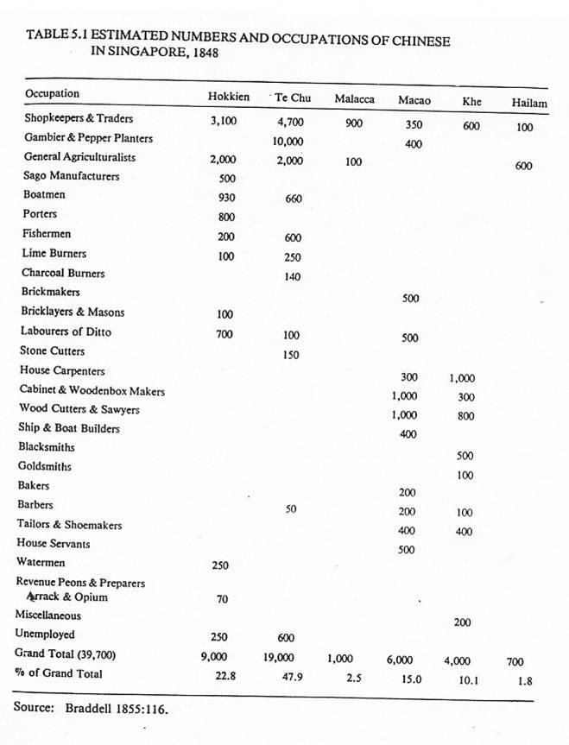

Slide 13
Formal and Informal Networks
Huiguan (association/organization)
Bang (or Pang) (帮) – group on dialect lines.
Clans – family, kinship, locality
Trade Associations – trade and dialect
Secret Societies

Slide 14
The trading environment: c.1870
Transformation as new technologies (steamships and telegraph) came to the fore.
A flourishing port environment
European merchants were always a small community and they relied heavily on Chinese and other traders.

Slide 15
Early Singapore’s Commercial life: Western trading houses and Chinese middlemen…
“The Chinese are indispensable to us, as they established connections in almost all the islands to which our foreign commodities are carried. … Their agents reside in Sumatra, Borneo, and on the Indo-Chinese mainland, collecting produce by barter with the natives, to whom they are frequently related by social, as well as by commercial ties.”
Singapore Free Press, 1874

Slide 16
How did trade operate?
An ethnic division of trading functions
European mercantile community
A ‘middleman’ role – the Chinese community
Local merchants and trade networks

Slide 17
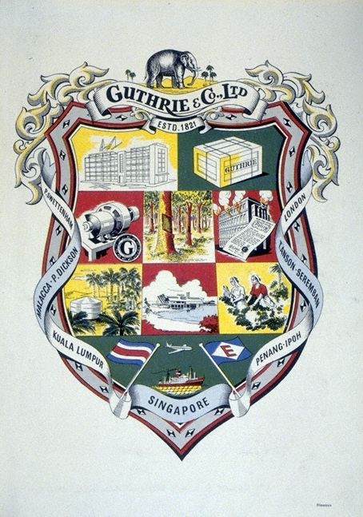
Western Trading Houses
Singapore: 20 Western merchant firms in late 1890, over 60 firms by 1908. (Mainly British firms).
These firms handled the westward trade of the port.
Generally, these firms maintained an office in London or Europe, with branches in Asia.
A preference & reliance on Chinese ‘middlemen’ to help conduct business. (Hokkien and Teochew communities)
Emblem for Guthries and Co.

Slide 18
CONCLUDING THOUGHTS…
The Chinese community played a major role in Singapore’s commercial life.
Many diversified from acting as merchants and agency house middlemen to a wide range of industries.
Temples played an important role in providing a focal point for the Chinese community
Trade specialization based on ethnicity/dialect was reinforced through clan/bang/temple membership.

Slide 19
Additional readings:
Works by Carl Trocki, Yen Ching-hwang, Wang Gungwu.
Singapore Federation of Chinese Clan Associations.
  http://www.sfcca.sg/en/node
  Gan Clan Association: http://ganclan.sg

